Slide 1
Bird
Samir Hauser, Connor Charlton, Joel Alder

Slide 2

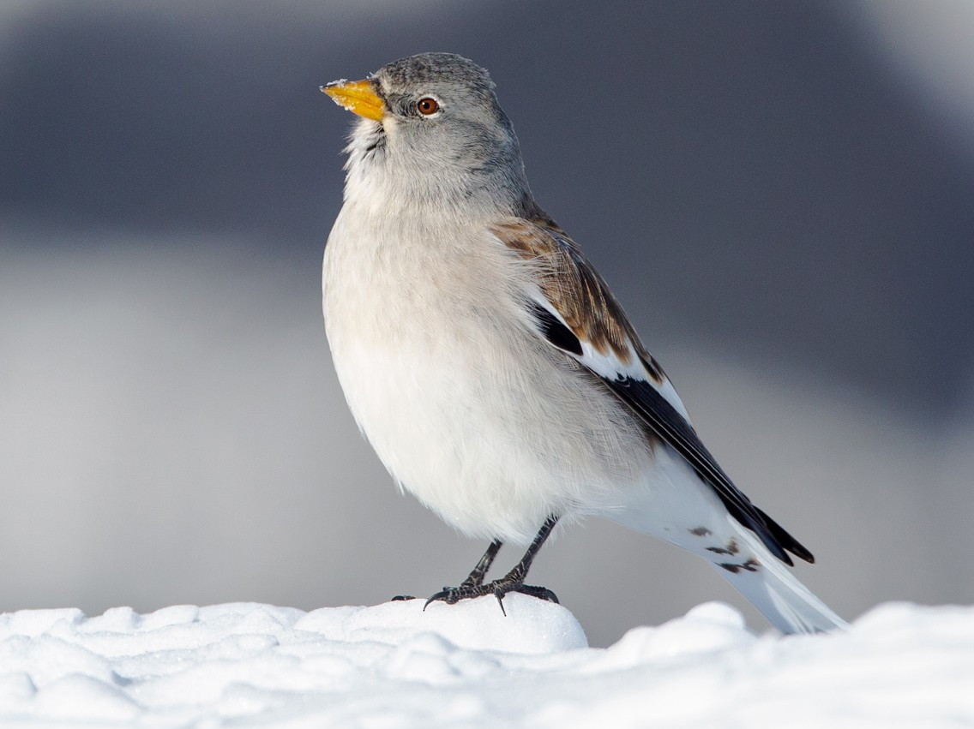
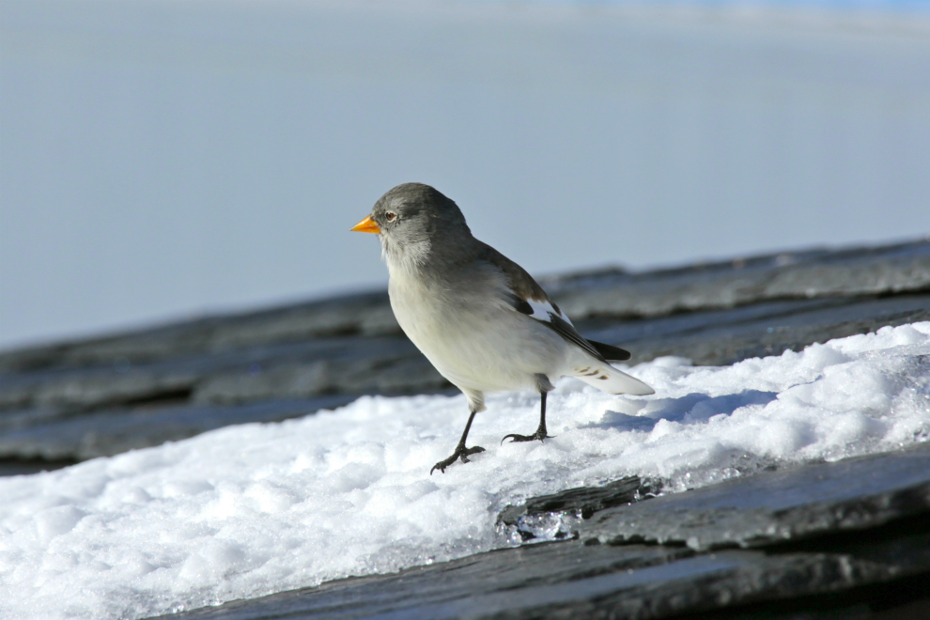
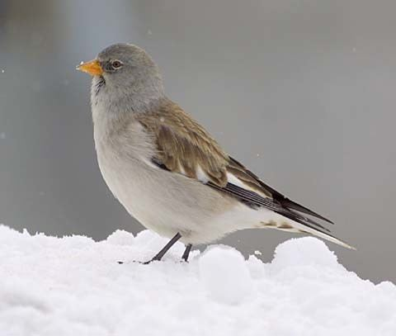
Snow-finches

Slide 3
Background
Survival chance of snow-finches depend on sex
Visually not possible to determine the sex
Chapture the birds and measure metomorpholigcal treats (weight, feather length, etc.)
Researcher determine the sex via a gene test
Main Goal: Possibility to determine the sex via the metomorpholigcal treats

Slide 4
Problem description
Develop a model that gives the probability for the sex via the methomorphical traits
Identify which measurements are important, that they know which one possibily to drop
Develop a model for the adult birds first and then incooparte nestlings data

Slide 5
Data description
CSV
2287 observations
There a lot of NAs (difficult to measure)
Name in data set | Description
Age | 1 = nestling , >1 : adult bird
Wing | length in mm
P1 / P8 | feather length
Tarsus | leg length
Weight | in g (strongly varies with time of year)
Fat | (0 = lean, 6 = fat)
Muscle | (0 = hardly any muscle, 3 = a lot of muscle)
Bill length | mm
Sex_genetic | response

Slide 6
Add some plots
Please add here fancy R plots

Slide 7
Approach
Regression to fill up the missing values
Logistic Regression and tree based methods for adult classifier
The same for the nestlings

